Slide 1
Relational Model

Slide 2
Introduction
The relational model was proposed by E. F.Codd in 1970.
It deals with database management from an abstract point of view.
The model provides specifications of an abstract database management system.
The precision is derived from solid theoretical foundation that includes predicate calculus and theory of relations.

Slide 3
Introduction(2)
Codd defined the model as consisting of the following three components:
Data Structure- a collection of data structure types for building the database.
Data Manipulation- a collection of operators that may be used to retrieve, derive or modify data stored in the data structures.
Data Integrity- a collection of rules that implicitly or explicitly define a consistent database state or changes of states.

Slide 4
Relational Model: Data structure
The beauty of the relational model is its simplicity of structure.
Its fundamental property is that all information about the entities and their attributes as well as the relationships is presented to the user as tables (called relations) and nothing but tables.
The rows of the tables may be as considered records (instances) and the columns as fields.
Each row therefore consists of an entity occurrence or a relationship occurrence.
Each column refers to an attribute.
The model is called relational and not tabular because tables are a lower level of abstractions than the mathematical concept of relation.
For example: Tables give the impression that positions of rows and columns are important while in the relational model, it is assumed that no ordering of rows and columns is defined.

Slide 5

Example of a Relation
Table/
Relation/
EntitySet
Column/
Attribute
Row/
Tuple/
Entity instance

Slide 6
Formal Definition of Data Structure
Formally, given sets D₁, D₂, …. D_{n} a relation r is a subset of
D₁ x D₂ x … x D_{n}
Thus, a relation is a set of n-tuples (a₁, a₂, …, a_{n}) where each a_{i} ∈ D_{i}
Example: If
customer_name = {Jones, Smith, Curry, Lindsay}
customer_street = {Main, North, Park}
customer_city = {Harrison, Rye, Pittsfield}
Then r = { (Jones, Main, Harrison),
(Smith, North, Rye),
(Curry, North, Rye),
(Lindsay, Park, Pittsfield) }
is a relation over (a subset of)
customer_name x customer_street x customer_city

Slide 7
Terminology used for Relations: Attribute Types
Each attribute of a relation has a name
The set of allowed values for each attribute is called the domain of the attribute
  e.g., the allowed value for age is an integer between 0 and 150.
Attribute values are (normally) required to be atomic; that is, indivisible
The special value null is a member of every domain
customer_name
customer_adress
customer_street
customer_city
Jones
Smith
Curry
Lindsay
Main
North
North
Park
Harrison
Rye
Rye
Pittsfield

Slide 8
Terminology cont’d - Relation Schema
A₁, A₂, … , A_{n} are attributes
R = (A₁, A₂, … , A_{n} ) is a relation schema
Example:
Customer_schema = (customer_name, customer_street, customer_city )
r(R ) is a relation on the relation schema R
Example:
customer (Customer_schema)

Slide 9
Terminology cont’d - Relation Instance
The current values ( relation instance ) of a relation are specified by a table ( snapshot at a given instant time )
An element t of r is a tuple, represented by a row in a table
attributes
(or columns)
customer_name
customer_street
customer_city
Jones
Smith
Curry
Lindsay
Main
North
North
Park
Harrison
Rye
Rye
Pittsfield
tuples
(or rows)
customer

Slide 10
Properties of a Relation
Each relation contains only one record type.
Each relation has a fixed number of columns that are explicitly named where each attribute name within a relation is unique.
No two rows in a relation are the same.
Each item or element in the relation is atomic, that is, in each row, every attribute has only one value that cannot be decomposed and therefore no repeating groups are allowed – Must be in First Normal Form.
Rows have no ordering associated with them.
Columns have no ordering associated with them (although most commercially available systems do).

Slide 11
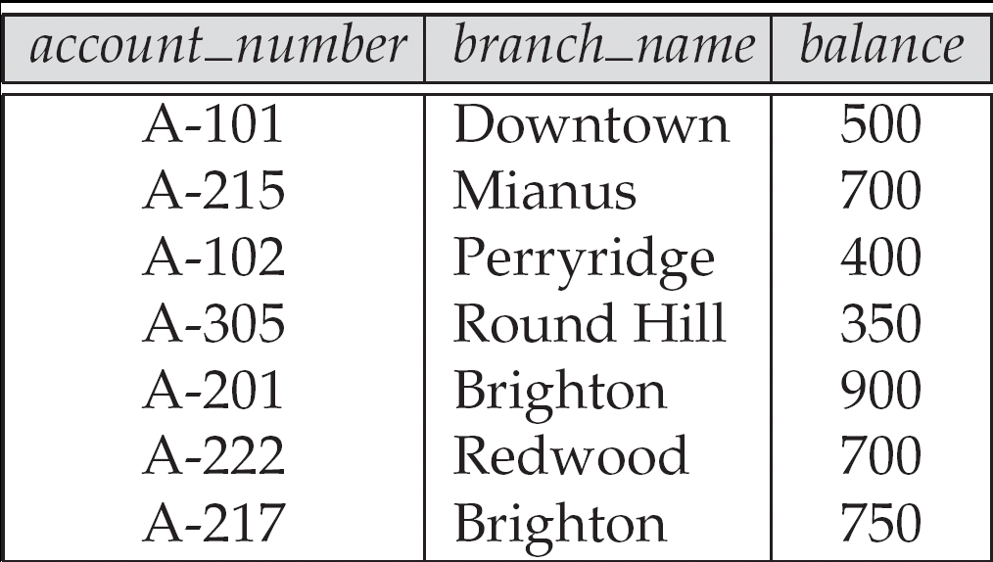
Example - Rows are Unordered
Order of tuples is irrelevant (tuples may be stored in an arbitrary order)
Example: account relation with unordered tuples

Slide 12
Summary of Data structure - Database
A database consists of multiple relations
Information about an enterprise is broken up into parts, with each relation storing one part of the information
account : stores information about accounts
depositor : stores information about which customer owns which account
customer : stores information about customers
Storing all information as a single relation such as
bank ( account_number, balance, customer_name, ... )
results in
  repetition of information ( e.g., two customers own an account)
  the need for null values (e.g., represent a customer without an account)
Normalization theory deals with how to design well structured relational schemas

Slide 13

Illustration - A customer Relation

Slide 14

Illustration (2) - A depositor Relation

Slide 15
Data Manipulation
The manipulative part of relational model makes set processing (or relational processing) facilities available to the user.
Since relational operators are able to manipulate relations, the user does not need to use loops in the application programs (– non-procedural Vs procedural).
The process of querying a relational database is in essence a way of manipulating the relations that are the database.

Slide 16
Data Manipulation (2)
E. F. Codd introduced two formal languages : Relational algebra and relational calculus , associated with the relational model.
Informally, relational algebra is a (high-level) procedural language and relational calculus a non-procedural language.
However, formally both are equivalent to one another.
Both exhibit the property of closure and completeness

Slide 17
Data Manipulation (3) - Query Languages
Language in which user requests information from the database.
Categories of languages
  Procedural
  Non-procedural, or declarative
“Pure” languages:
  Relational algebra
  Tuple relational calculus
  Domain relational calculus
Pure languages form underlying basis of query languages that people use.

Slide 18
Relational Algebra
Procedural language
Six basic operators
  select: σ
  project: ∏
  union: ∪
  set difference: –
  Cartesian product: x
  rename: ρ
The operators take one or two relations as inputs and produce a new relation as a result - closure.

Slide 19
Select Operation – Example
Relation r
A
B
C
D
α
α
β
β
α
β
β
β
1
5
12
23
7
7
3
10
σ_{A=B ^ D > 5} (r)
A
B
C
D
α
β
α
β
1
23
7
10

Slide 20
Select Operation
Notation: σ _{p}(r)
p is called the selection predicate
Defined as:
σ_{p}(r) = {t | t ∈ r and p(t)}
Where p is a formula in propositional calculus consisting of terms connected by : ∧ (and), ∨ (or), ¬ (not)
Each term is one of:
<attribute>op <attribute> or <constant>
where op is one of: =, ≠, >, ≥. <. ≤
Example of selection:
σ _{branch_name=“Perryridge”}(account)

Slide 21
Project Operation – Example
A
B
C
Relation r:
α
α
β
β
10
20
30
40
1
1
1
2
A
C
A
C
∏_{A,C} (r)
α
α
β
β
1
1
1
2
α
β
β
1
1
2
=

Slide 22

Project Operation
Notation:
where A₁, A₂ are attribute names and r is a relation name.
The result is defined as the relation of k columns obtained by erasing the columns that are not listed
Duplicate rows removed from result, since relations are sets
Example: To eliminate the branch_name attribute of account
∏_{account_number, balance} (account)

Slide 23
Union Operation – Example
Relations r, s:
A
B
A
B
α
α
β
1
2
1
α
β
2
3
s
r
A
B
α
α
β
β
1
2
1
3
r ∪ s:

Slide 24
Union Operation
Notation: r ∪ s
Defined as:
r ∪ s = { t | t ∈ r or t ∈ s }
For r ∪ s to be valid.
1. r, s must have the same arity (same number of attributes)
2. The attribute domains must be compatible (example: 2nd column of r deals with the same type of values as does the 2nd column of s)
Example: to find all customers with either an account or a loan
∏_{customer_name} (depositor) ∪ ∏_{customer_name} (borrower)

Slide 25
Set Difference Operation – Example
Relations r, s:
A
B
A
B
α
α
β
1
2
1
α
β
2
3
s
r
r – s:
A
B
α
β
1
1

Slide 26
Set Difference Operation
Notation r – s
Defined as:
r – s = { t | t ∈ r and t ∉ s }
Set differences must be taken between compatible relations.
  r and s must have the same arity
  attribute domains of r and s must be compatible

Slide 27
Cartesian-Product Operation – Example
Relations r, s:
A
B
C
D
E
α
β
1
2
α
β
β
γ
10
10
20
10
a
a
b
b
r
s
r x s:
A
B
C
D
E
α
α
α
α
β
β
β
β
1
1
1
1
2
2
2
2
α
β
β
γ
α
β
β
γ
10
10
20
10
10
10
20
10
a
a
b
b
a
a
b
b

Slide 28
Cartesian-Product Operation
Notation r x s
Defined as:
r x s = {t q | t ∈ r and q ∈ s}
Assume that attributes of r(R) and s(S) are disjoint. (That is, R ∩ S = ∅).
If attributes of r(R) and s(S ) are not disjoint, then renaming must be used.

Slide 29
Composition of Operations
Can build expressions using multiple operations
Example: σ_{A=C}(r x s)
r x s
σ_{A=C}(r x s)
A
B
C
D
E
α
α
α
α
β
β
β
β
1
1
1
1
2
2
2
2
α
β
β
γ
α
β
β
γ
10
10
20
10
10
10
20
10
a
a
b
b
a
a
b
b
A
B
C
D
E
α
β
β
1
2
2
α
β
β
10
10
20
a
a
b

Slide 30
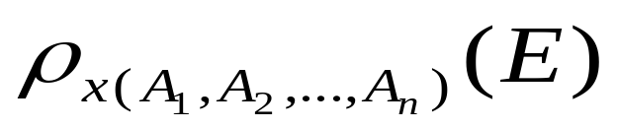
Rename Operation
Allows us to name, and therefore to refer to, the results of relational-algebra expressions.
Allows us to refer to a relation by more than one name.
Example:
ρ _{x} (E)
returns the expression E under the name X
If a relational-algebra expression E has arity n, then
returns the result of expression E under the name X, and with the attributes renamed to A₁ , A₂ , …., A_{n} .

Slide 31

Banking Example
branch (branch_name, branch_city, assets)
customer (customer_name, customer_street, customer_city)
account (account_number, branch_name, balance)
loan (loan_number, branch_name, amount)
depositor (customer_name, account_number)
borrower (customer_name, loan_number)

Slide 32
Example Queries
Find all loans of over $1200
loan
Loan_number | Branch_name | amount
σ_{amount > 1200} (loan)
Find the loan number for each loan of an amount greater than $1200
∏_{loan_number} (σ_{amount} _{> 1200} (loan))

Slide 33
Example Queries
Find the names of all customers who have a loan, an account, or both, from the bank
  ∏_{customer_name} (borrower) ∪ ∏_{customer_name} (depositor)
Find the names of all customers who have a loan and an account at bank.
  ∏_{customer_name} (borrower) ∩ ∏_{customer_name} (depositor)
borrower
depositor
customer_name | Load_number
customer_name | account_number

Slide 34
Example Queries
Find the names of all customers who have a loan at the Perryridge branch.
∏_{customer_name} (σ_{branch_name=“Perryridge”}
(σborrower.loan_number = loan.loan_number(borrower x loan)))
Find the names of all customers who have a loan at the
Perryridge branch but do not have an account at any branch of
the bank.
∏_{customer_name} (σ_{branch_name = “Perryridge”}
(σborrower.loan_number = loan.loan_number(borrower x loan))) –
∏_{customer_name}(depositor)
loan
borrower
Loan_number | Branch_name | amount
customer_name | Load_number

Slide 35
Example Queries
Find the names of all customers who have a loan at the Perryridge branch.
  Query 1
  ∏_{customer_name} (σ_{branch_name = “Perryridge”} (
  σborrower.loan_number = loan.loan_number (borrower x loan)))
  Query 2
  ∏_{customer_name}(σloan.loan_number = borrower.loan_number (
  (σ_{branch_name = “Perryridge”} (loan)) x borrower))
loan
borrower
Loan_number | Branch_name | amount
customer_name | Load_number

Slide 36
Additional Operations
We define additional operations that do not add any power to the relational algebra, but that simplify common queries.
Set intersection
Natural join
Division
Assignment

Slide 37
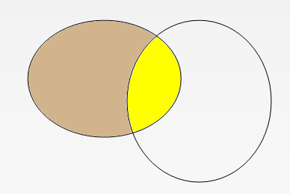
Set-Intersection Operation
Notation: r ∩ s
Defined as:
r ∩ s = { t | t ∈ r and t ∈ s }
Assume:
  r, s have the same arity
  attributes of r and s are compatible
Note: r ∩ s = r – (r – s)
r
s

Slide 38
Set-Intersection Operation – Example
Relation r, s:
r ∩ s
A B
A B
α
α
β
1
2
1
α
β
2
3
r
s
A B
α 2

Slide 39
Natural-Join Operation
Notation: r s
Let r and s be relations on schemas R and S respectively.
Then, r s is a relation on schema R ∪ S obtained as follows:
  Consider each pair of tuples t_{r} from r and t_{s} from s.
  If t_{r} and t_{s} have the same value on each of the attributes in R ∩ S, add a tuple t to the result, where
    t has the same value as t_{r} on r
    t has the same value as t_{s} on s
Example:
  R = (A, B, C, D)
  S = (E, B, D)
  Result schema = (A, B, C, D, E)
  r s is defined as:
  ∏_{r.A, r.B, r.C, r.D, s.E} (σ_{r.B = s.B} ∧ _{r.D = s.D} (r x s))

Slide 40
Natural Join Operation – Example
Relations r, s:
A
B
C
D
B
D
E
α
β
γ
α
δ
1
2
4
1
2
α
γ
β
γ
β
a
a
b
a
b
1
3
1
2
3
a
a
a
b
b
α
β
γ
δ
∈
r
s
r s
A
B
C
D
E
α
α
α
α
δ
1
1
1
1
2
α
α
γ
γ
β
a
a
a
a
b
α
γ
α
γ
δ

Slide 41
Division Operation
r ÷ s
Notation:
Suited to queries that include the phrase “for all”.
Let r and s be relations on schemas R and S respectively where
  R = (A₁, …, A_{m} , B₁, …, B_{n} )
  S = (B₁, …, B_{n})
  The result of r ÷ s is a relation on schema
  R – S = (A₁, …, A_{m})
  r ÷ s = { t | t ∈ ∏ _{R-S} (r) ∧ ∀ u ∈ s ( tu ∈ r ) }
  Where tu means the concatenation of tuples t and u to produce a single tuple

Slide 42
Division Operation – Example
Relations r, s:
A
B
B
α
α
α
β
γ
δ
δ
δ
∈
∈
β
1
2
3
1
1
1
3
4
6
1
2
1
2
s
r ÷ s:
A
r
α
β
r ÷ s = { t | t ∈ ∏ _{R-S} (r) ∧ ∀ u ∈ s ( tu ∈ r ) }

Slide 43
Another Division Example
Relations r, s:
A
B
C
D
E
D
E
α
α
α
β
β
γ
γ
γ
a
a
a
a
a
a
a
a
α
γ
γ
γ
γ
γ
γ
β
a
a
b
a
b
a
b
b
1
1
1
1
3
1
1
1
a
b
1
1
s
r
r ÷ s:
A
B
C
α
γ
a
a
γ
γ
r ÷ s = { t | t ∈ ∏ _{R-S} (r) ∧ ∀ u ∈ s ( tu ∈ r ) }

Slide 44
Assignment Operation
The assignment operation (←) provides a convenient way to express complex queries.
  Write query as a sequential program consisting of
    a series of assignments
    followed by an expression whose value is displayed as a result of the query.
  Assignment must always be made to a temporary relation variable.
Example: Write r ÷ s as
temp1 ← ∏_{R-S} (r )
temp2 ← ∏_{R-S} ((temp1 x s ) – ∏_{R-S,S} (r ))
result = temp1 – temp2

Slide 45
Bank Example Queries
Find the names of all customers who have a loan and an account at bank.
  ∏_{customer_name} (borrower) ∩ ∏_{customer_name} (depositor)
Find the name of all customers who have a loan at the bank and the loan amount

Slide 46
Bank Example Queries
Find all customers who have an account from at least the “Downtown” and the “Uptown” branches.
  Query 1
    ∏_{customer_name} (σ_{branch_name = “Downtown”} (depositor account )) ∩
    ∏_{customer_name} (σ_{branch_name = “Uptown”} (depositor account))
  Query 2
  ∏_{customer_name, branch_name} (depositor account)
  ÷ ρ_{temp(branch_name)} ({(“Downtown” ), (“Uptown” )})
  Note that Query 2 uses a constant relation.

Slide 47
Example Queries
Find all customers who have an account at all branches located in Brooklyn city.
∏_{customer_name, branch_name} (depositor account)
÷ ∏_{branch_name} (σ_{branch_city = “Brooklyn”} (branch))

Slide 48
Extended Relational-Algebra-Operations
Aggregate Functions
Generalized Projection (read by yourself)
Outer Join (read by yourself)

Slide 49

Aggregate Functions and Operations
Aggregation function takes a collection of values and returns a single value as a result.
avg: average value
min: minimum value
max: maximum value
sum: sum of values
count: number of values
Aggregate operation in relational algebra
E is any relational-algebra expression
  G₁, G₂ …, G_{n} is a list of attributes on which to group (can be empty, for all)
  Each F_{i} is an aggregate function
  Each A_{i} is an attribute name

Slide 50
Aggregate Operation – Example
Relation r:
A
B
C
α
α
β
β
α
β
β
β
7
7
3
10
g _{sum(c)} (r)
sum(c )
27

Slide 51
Aggregate Operation – Example
Relation account grouped by branch-name:
branch_name
account_number
balance
Perryridge
Perryridge
Brighton
Brighton
Redwood
A-102
A-201
A-217
A-215
A-222
400
900
750
750
700
_{branch_name} g _{sum(balance)} (account)
branch_name
sum(balance)
Perryridge
Brighton
Redwood
1300
1500
700

Slide 52
Aggregate Functions (Cont.)
Result of aggregation does not have a name
  Can use rename operation to give it a name
  For convenience, renaming is permitted as part of an aggregate operation
_{branch_name} g _{sum(balance) as sum_balance} (account)

Slide 53
Data integrity
This are discussed in the next class – read Rai foundation Lecture notes – lecture 8

Slide 54
Further reading
Connoly and Begg – Chapter 4
Rai foundation Notes – lectures 5 - 8

